Slide 1

AML Air Conditioning & Electrical SE0 Report
(1st April to 10th April 2026)

Slide 2
Google Listing Ranking
(Current Position)
S.No | Keyword | Current Position
1 | air conditioning electrical blacktown | 1
2 | aircon electrical blacktown | 1
3 | aircon electrician blacktown | 1
4 | air conditioning and electrical services blacktown | 2
5 | air conditioning marayong | 1
6 | ducted system marayong | 1
7 | AML Air Conditioning & Electrical | 1
8 | blacktown air conditioning repairs | 5
9 | industrial air conditioning installation blacktown | 6
10 | aircon repair blacktown | 3
11 | air conditioning installation blacktown | 6

Slide 3
Keywords Ranking
(Current Ranking)
S.No | Keyword | Ranking Position
1 | aircon electrical blacktown | 1
2 | AML Air Conditioning & Electrical | 1
3 | air conditioning electrical blacktown | 1
4 | air conditioning marayong | 1
5 | air conditioning and electrical services blacktown | 1
6 | ducted system marayong | 2
7 | air conditioning blacktown | 5
8 | aircon electrician blacktown | 4
9 | industrial air conditioning installation blacktown | 12
10 | Air Conditioning Installation & Maintenance blacktown | 6

Slide 4
Keywords Ranking
(Current Ranking)
S.No | Keyword | Ranking Position
11 | air conditioning installation blacktown | 5
12 | aircon installation blacktown | 5
13 | ducted air conditioning installation blacktown | 8
14 | air conditioner installation blacktown | 6
15 | air conditioning installation blacktown | 5
16 | air conditioning blacktown nsw | 5

Slide 5
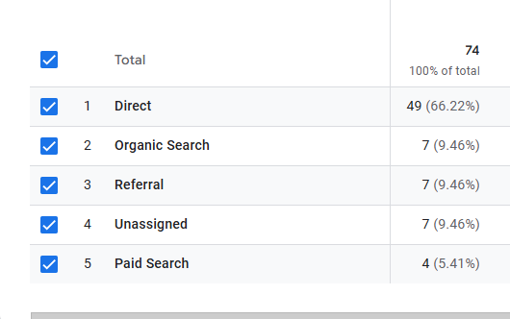
Website Analytics
Traffic Acquisition - (1st April to 10th April 2026)

Slide 6
THANK YOU

